Slide 1
33MOhm – noise measurement
Date: 06012020 and 09012020
Different measurement configurations
Inside and outside the chamber (not main chamber)
Increased source current
Do the measurement circumstances matter?
Does the noise come from the voltage measurement as before?
Does the noise decrease when the DUT is inside the chamber?
Does an increased source current lead to less noise in the absolute sense, not percentagewise?
Does the noise decrease when negative voltage is measured?

Slide 2
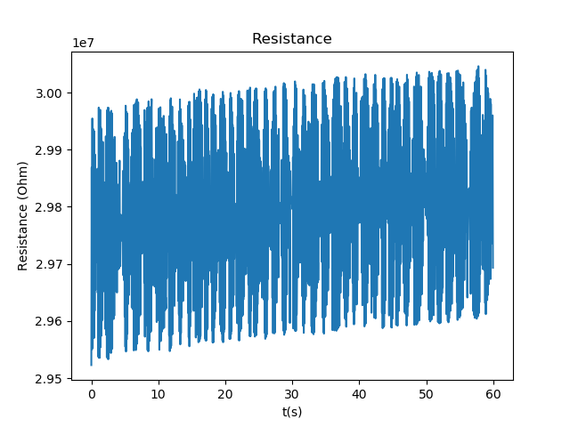
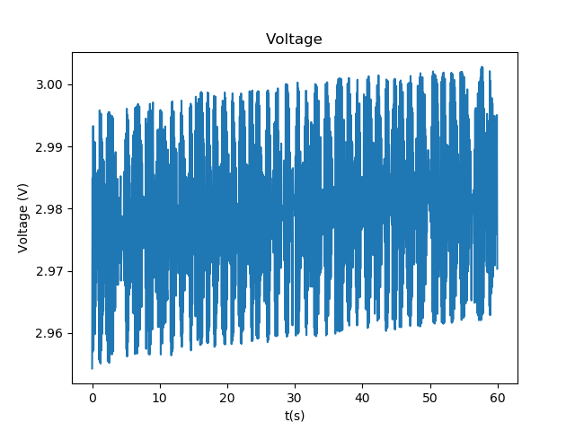
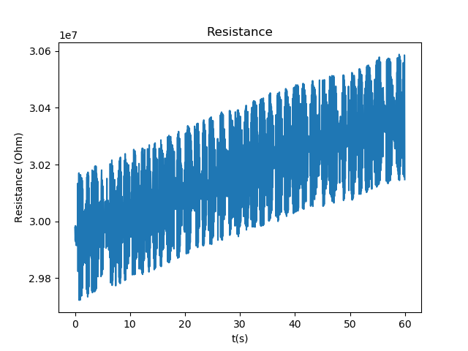
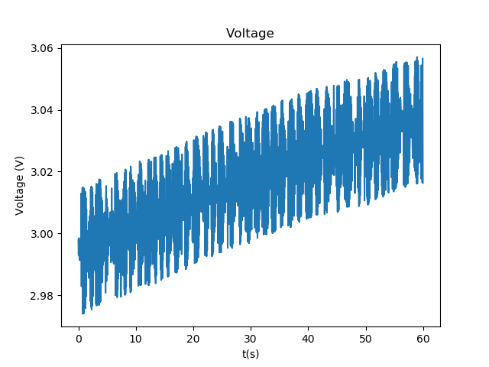
33MOhm – Inside / Outside
0109_1835_33MOhm_forward_inside
Measurement is done with current sourcing
Sample rate is 20 Hz
Measurement time is 60 s
Source current is 1e-07 A
Limit voltage starts at 10.0 V
Mean resistance is 2.979374e+07 with std 1.581395e+05
Mean voltage is 2.979317e+00 with std 1.412592e-02
Mean current is 9.999841e-08 with std 6.793682e-11
0109_1840_33MOhm_forward_outside
Measurement is done with current sourcing
Sample rate is 20 Hz
Measurement time is 60 s
Source current is 1e-07 A
Limit voltage starts at 10.0 V
Mean resistance is 3.017038e+07 with std 2.012205e+05
Mean voltage is 3.016969e+00 with std 1.875031e-02
Mean current is 9.999802e-08 with std 7.089560e-11
Slight decrease in noise when DUT is inside the chamber, so most of the noise is coming from the outside wires (as the chamber is grounded – Faraday cage)

Slide 3
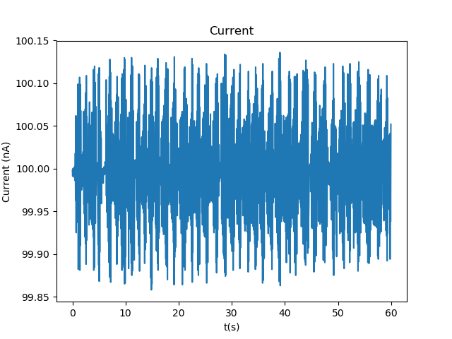
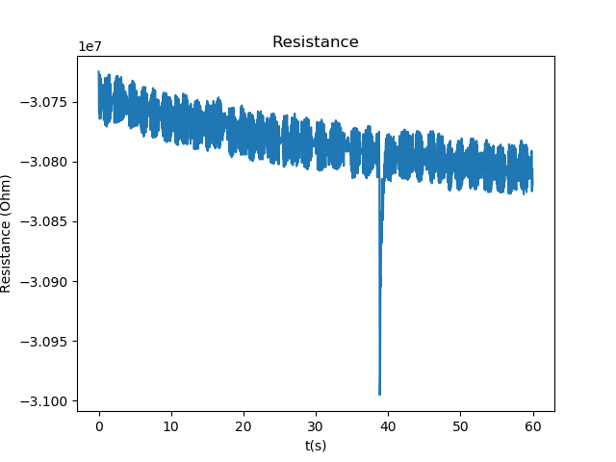
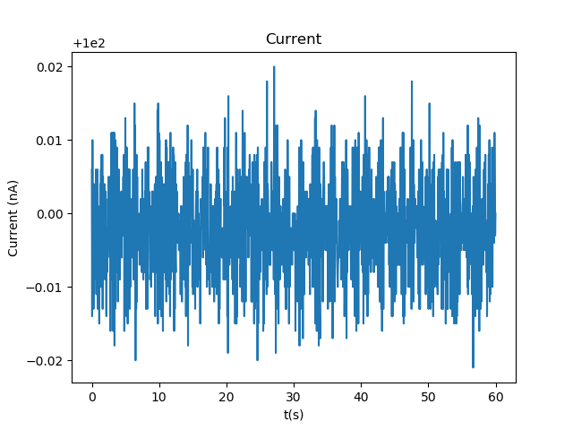
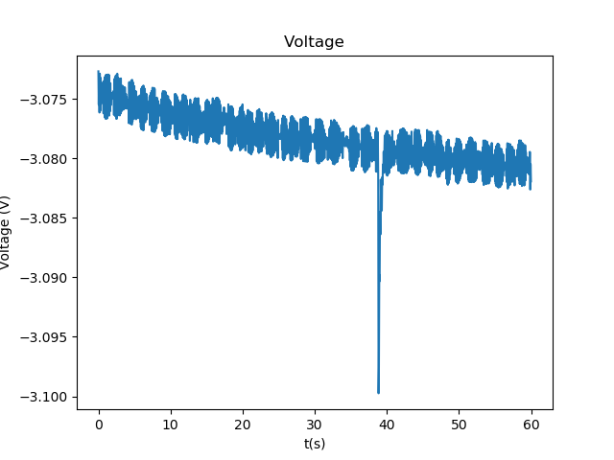
33MOhm – Forward / Backward
0109_1840_33MOhm_forward_outside
Measurement is done with current sourcing
Sample rate is 20 Hz
Measurement time is 60 s
Source current is 1e-07 A
Limit voltage starts at 10.0 V
Mean resistance is 3.017038e+07 with std 2.012205e+05
Mean voltage is 3.016969e+00 with std 1.875031e-02
Mean current is 9.999802e-08 with std 7.089560e-11
0109_1843_33MOhm_backward_outside
Measurement is done with current sourcing
Sample rate is 20 Hz
Measurement time is 60 s
Source current is 1e-07 A
Limit voltage starts at 10.0 V
Mean resistance is -3.078391e+07 with std 2.506476e+04
Mean voltage is -3.078322e+00 with std 2.419807e-03
Mean current is 9.999775e-08 with std 7.145656e-12
Backward sensing has factor 10 lower noise on the voltage, so it seems like this configuration should result in lower noise also when applied to other devices, but this is not the case as for WO3196 this was tried, but it made no difference in terms of the voltage noise

Slide 4
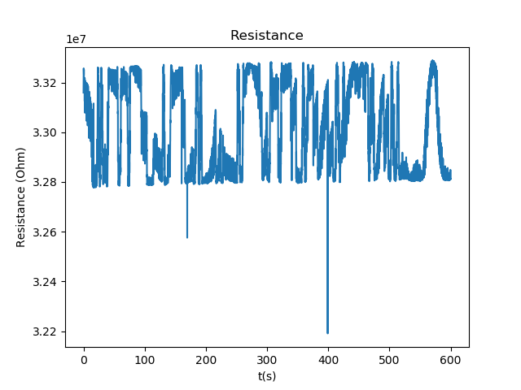
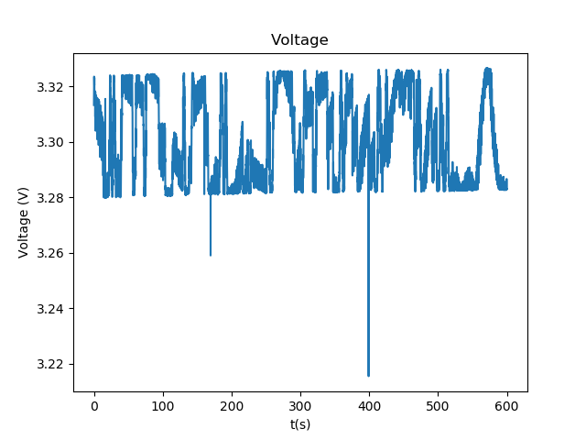
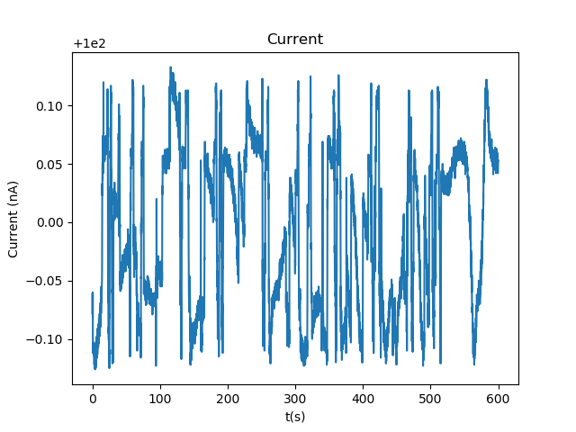
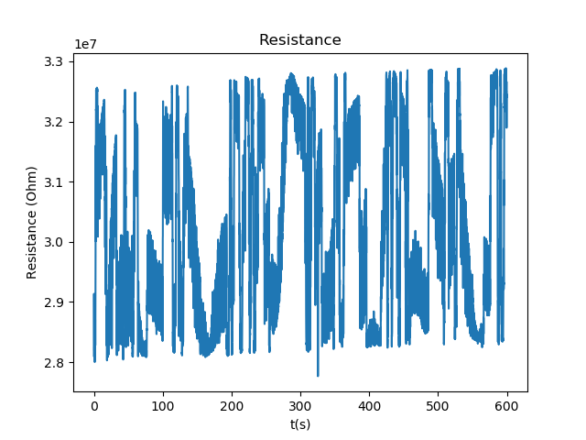
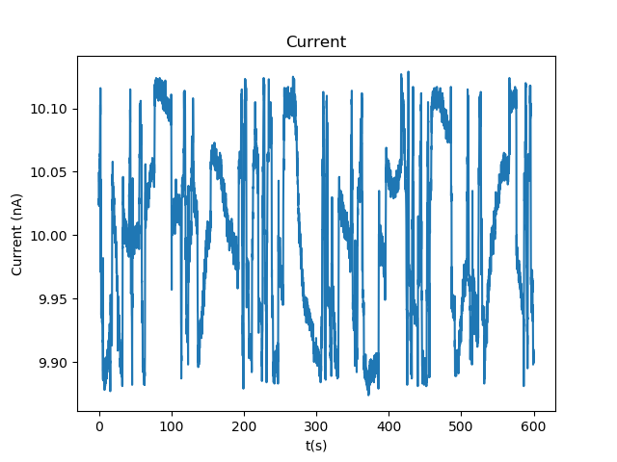
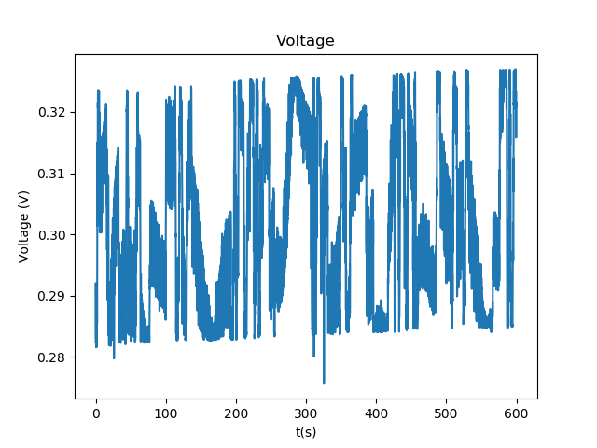
33MOhm – Source current variation
0106_1838_33MOhm_inside_highersource
Sample rate is 10 Hz
Measurement time is 600 s
Source current is 1e-07 A
Limit voltage starts at 10.0 V
Mean resistance is 3.302303e+07 with std 1.810187e+05
Mean voltage is 3.302002e+00 with std 1.619875e-02
Mean current is 9.999122e-08 with std 6.782057e-11
0106_1820_33MOhm_inside
Sample rate is 10 Hz
Measurement time is 600 s
Source current is 1e-08 A
Limit voltage starts at 1.0 V
Mean resistance is 3.023224e+07 with std 1.537301e+06
Mean voltage is 3.022526e-01 with std 1.370331e-02
Mean current is 1.000056e-08 with std 6.976061e-11
Voltage noise has the same amplitude in both case, but due to the different mean value the measurement with the higher source current has less noise compared to the mean voltage value and is therefore more accurate when measuring the resistance

Slide 5
33MOhm – high sample rate
Date: 01072020
Sample rate achieved? 57Hz
How much noise? Still Vstd of ~1E-2
FFT results

Slide 6
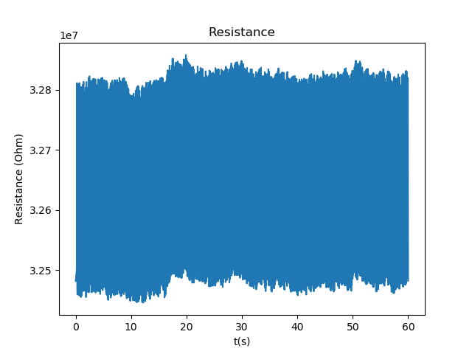
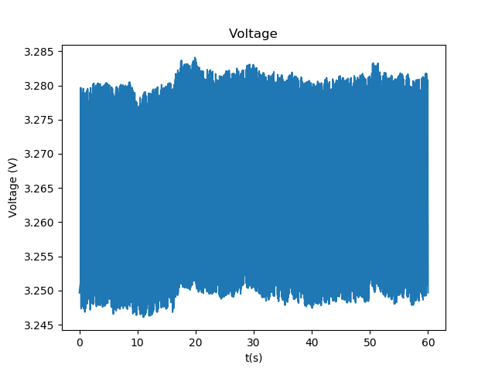
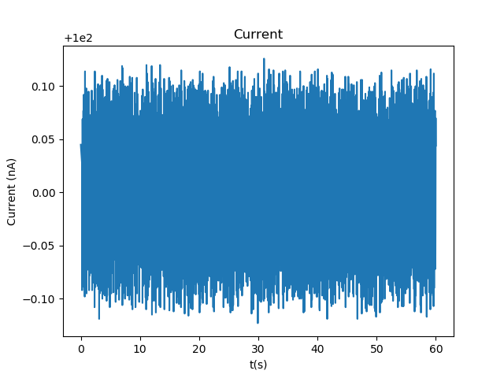
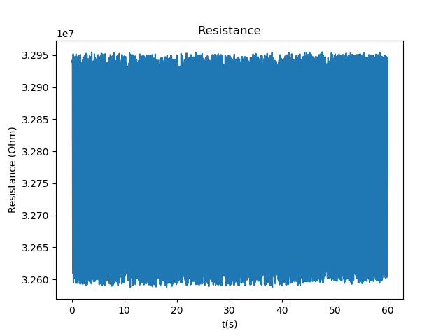
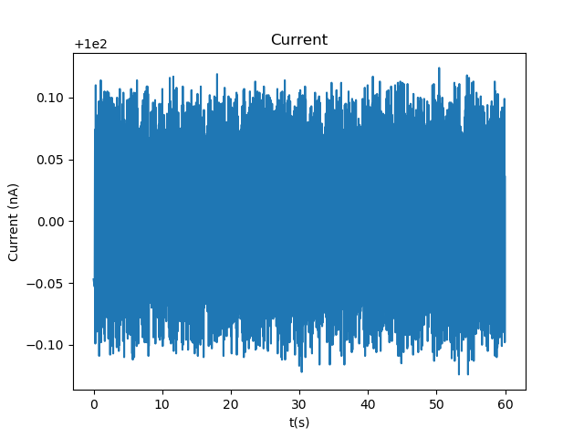
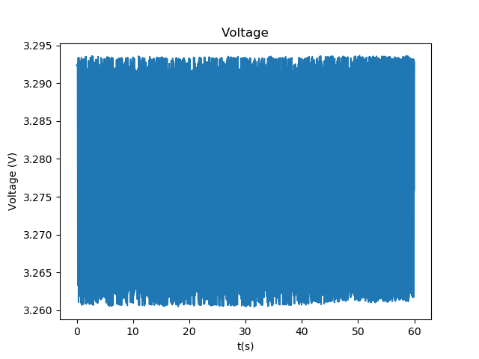
33MOhm – 2 vs 4 wire mode (forward)
0107_1745_33MOhm_highsamplerate
Sample rate is 200 Hz
Measurement time is 60 s
Source current is 1e-07 A
Limit voltage starts at 10.0 V
Mean resistance is 3.264955e+07 with std 1.322039e+05
Mean voltage is 3.264952e+00 with std 1.156368e-02
Mean current is 1.000001e-07 with std 6.029478e-11
0107_1748_33MOhm_highsamplerate_2wire_log
Sample rate is 200 Hz
Measurement time is 60 s
Source current is 1e-07 A
Limit voltage starts at 10.0 V
Mean resistance is 3.277222e+07 with std 1.317805e+05
Mean voltage is 3.277198e+00 with std 1.150702e-02
Mean current is 9.999947e-08 with std 6.061577e-11
Setting the SM to 4 wire setting does not seem to matter for the forward configuration. For the backward configuration it matters as it does not measure negative voltage if not set to 4 wire, but have no measurement data to support this

Slide 7
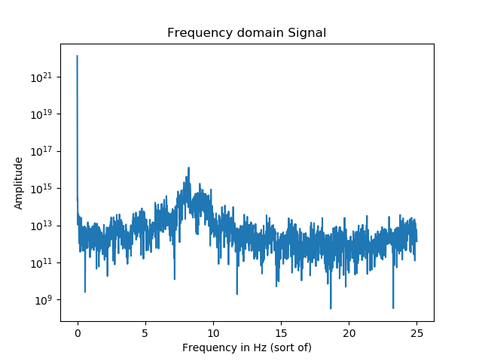
33MOhm – high sample rate + FFT
0107_1745_33MOhm_highsamplerate
Sample rate is 200 Hz
Measurement time is 60 s
Source current is 1e-07 A
Limit voltage starts at 10.0 V
Mean resistance is 3.264955e+07 with std 1.322039e+05
Mean voltage is 3.264952e+00 with std 1.156368e-02
Mean current is 1.000001e-07 with std 6.029478e-11
The average time between samples is 1.729E-02 with std 3.65E-03, the average sample rate is thus 57.83 Hz. This means that it is not possible to see if the noise comes from the electricity network which operates at 60 Hz. For this a sample rate of at least 120 Hz is needed.
The FFT to the right is from the resistance data.
The x-axis is in Hz, but not exactly as the time between samples is not constant, but for the FFT this is assumed anyway. To take this into account would be far too much work for little result, as it requires recreating the data with f.e. splines so it can be supersampled. But this won’t show if the 60 Hz anyway

